Slide 1

Licences
Notes:
This presentation will help you to build on your knowledge about Creative Commons by exploring in detail the principles of the licences, the conditions that underpin all the licence expressions, and the resulting licences and their characteristics.

Slide 2
A simple, standardized, legally robust way to grant © permissions to cultural works and data
Notes:
Creative Commons licences provide a standardized way to give the public permission to share and use your creative work — on conditions of your choice.
CC licenses let you easily change your copyright terms from the default of “all rights reserved” to “some rights reserved.”
A CC licence sits alongside copyright. CC licenses do not reduce, limit, or restrict any rights under exceptions and limitations to copyright, such as fair use or fair dealing. If your use of CC-licensed material would otherwise be allowed because of an applicable exception or limitation, you do not need to rely on the CC license or comply conditions. In general, private personal use does not require the permission of the licensor and, therefore, does not require that the conditions of the CC license be followed.
Note that moral rights still apply
CC is suitable for all copyright-able material (except software)

Slide 3

Notes:
CC filled the gap between “all rights reserved” and the public domain. Before CC, a creator could either reserve all rights or give them all way. With CC, a creator can now maintain their copyright, while granting certain reuse permissions to the public.
When you find a work that has been released under a Creative Commons licence, you are always free to share, copy, and redistribute it in any medium or format. This permission cannot be taken away, as long as you follow the license conditions.
CC uses icons which have gained full international recognition and which are not language specific

Slide 4

All licences are effective everywhere
Notes:
For version 3.0 and earlier, Creative Commons has also offered ported versions of its six core licenses for many jurisdictions (which usually correspond to countries, but not always). These ported licenses are based on the international license suite but have been modified to reflect local nuances in the expression of legal terms and conditions, drafting protocols, and language. The ported licenses and the international licenses are all intended to be legally effective everywhere. CC expects that few, if any, ports will be necessary for 4.0.
CC recommends that you take advantage of the improvements in the 4.0 suite explained on the license versions page unless there are particular considerations you are aware of that would require a ported license.

Slide 5
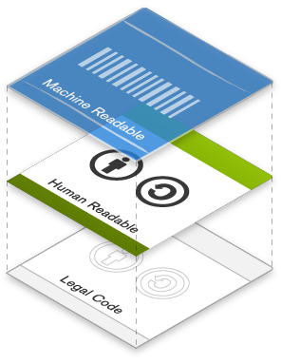
Notes:
All of our legal tools are designed with the web in mind. CC licenses have a unique 3 layer design, which is a fancy way of saying that you can communicate the license in three ways: one way for lawyers, one way for normal users, and one way for machines.
This layered design is part of what makes CC the global standard for copyright licensing.

Slide 6
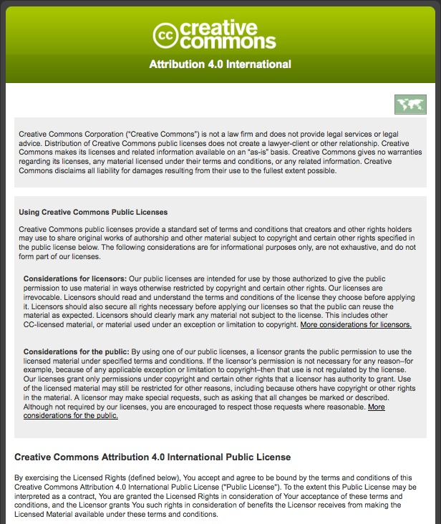
Lawyer
Readable
Legal Code
Notes:
So just a quick snapshot of each - the first, base layer is the actual license, the document that lawyers around the world have drafted and vetted so that the license works like it’s supposed to according to domestic and international copyright laws. We call this the legal code - written by and for lawyers.

Slide 7
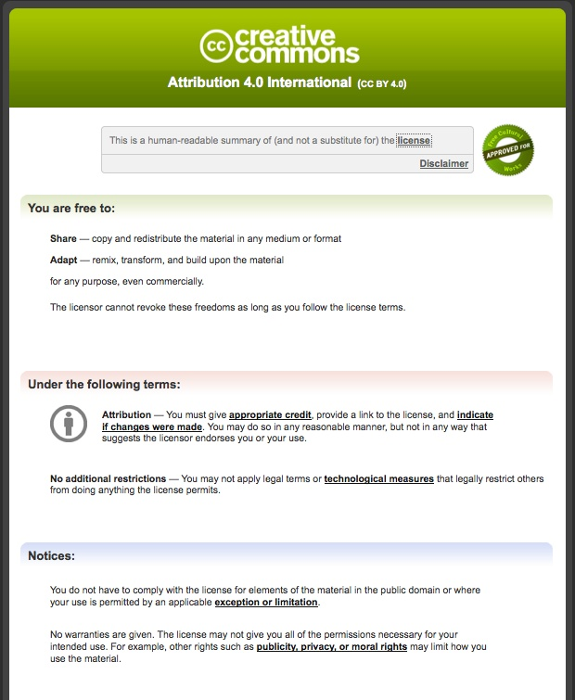
Human
Readable Deed
Notes:
The second layer is written in a format that any user could read and understand.
We call this the “human readable” summary of the license, which sums up the most important terms and conditions of the license in non-technical language.
One way to think of it is as the user-friendly interface to the actual license.

Slide 8
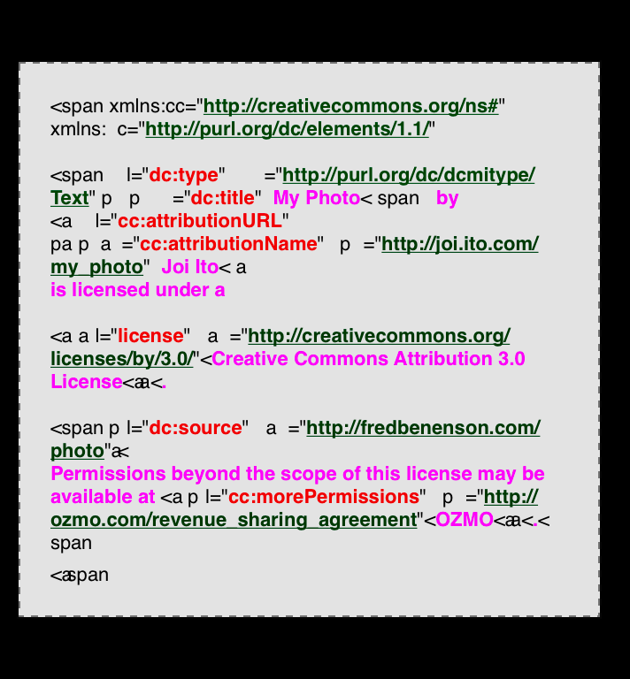
Machine
Readable Metadata
Notes:
The third and final layer is the machine-readable metadata. This is what really makes our tools really relevant for the digital age. This small snippet of HTML code summarizes the license and associated metadata (such as author and date) into a format that software, search engines, and other kinds of technology can understand.
When you choose a licence, the licence chooser automatically generates HTML code to produce the following licence notice for you (see licence chooser later in the presentation). All you have to do is copy and paste it into you your webpage editor.
When someone clicks on the icon or the licence name in the notice, they are taken to the Commons Deed for that licence.

Slide 9
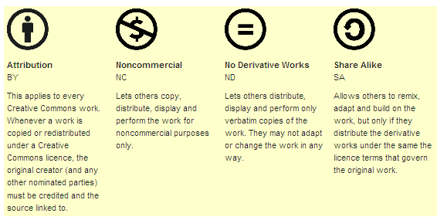
CC- Conditions
http://creativecommons.org.au/
Notes:
Some Rights Reserved
allow content creators to specify the limits that apply to reuse of their work when they make it available online.
The four different licence terms are:
Attribution: You must always provide credit to the original author.
Share-Alike: If you remix, transform, or build upon the material, you must distribute your contributions under the same license as the original.
Non-Commercial: You may not use the material for commercial purposes.
No-Derivatives: You may not distribute modified versions of the work.

Slide 10


Public Domain Dedication
Licenses
Notes:
The four conditions can be combined legally in six ways, resulting in six CC licenses. They are featured here on a spectrum of the most open license, which is CC Attribution, to the most restrictive license, which is CC Attribution-Noncommercial-NoDerivatives.
At the top is CC0, our public domain dedication tool, which is another legal tool we offer for those institutions wishing to waive their copyright in a work. In addition to our licenses, we offer two public domain tools which are used the most by cultural heritage institutions. CC0 will figure in the examples of museum uses of CC later.
The “free cultural Works seal” is applied to the Creative Commons licences that qualify as Free Culture Licenses according to the Definition of Free Cultural Public domain is not a license, but is also an acceptable copyright status for free cultural works according to the Definition. This seal and approval signals an important delineation between less and more restrictive licenses, one that creators and users of content should be aware of.
some important projects accept only freely (as defined) licensed or public domain content, in particular Wikipedia and Wikimedia sites, which use the Definition of Free Cultural Works in their licensing guidelines.
A free cultural work must not restrict any particular kind of use-
Freedom to use the work itself
Freedom to use the information in the work for any purpose
Freedom to share copies of the work for any purpose
Freedom to make and share remixes and other derivatives for any purpose
“Cultural works” is simply the term chosen by Freedom Defined to distinguish non-software works that should be under a free content license rather than a free software license.

Slide 11
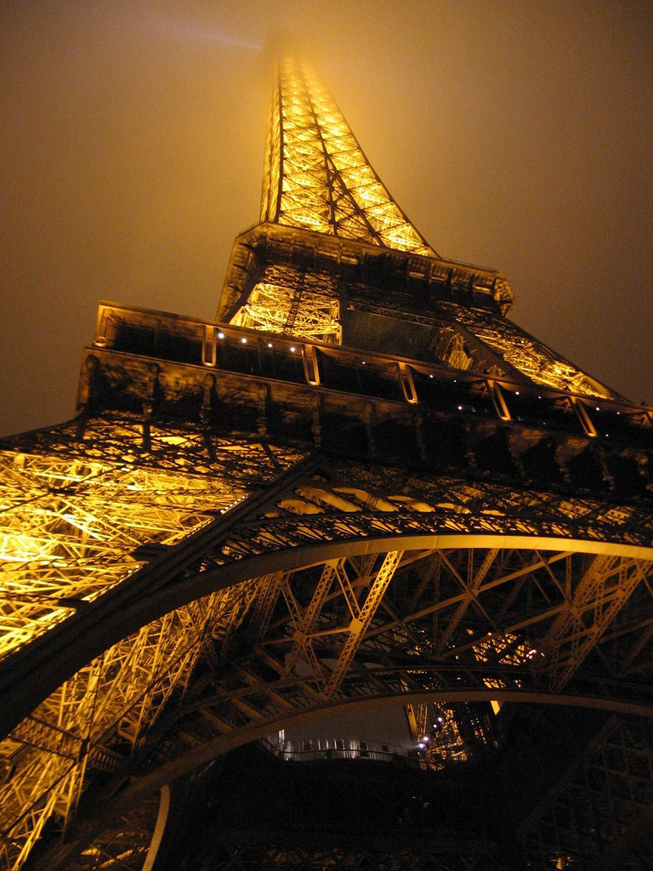
CC BY
Notes:
This license lets others distribute, remix, tweak, and build upon your work, even commercially, as long as they credit you for the original creation. This is the most accommodating of licenses offered. Recommended for maximum dissemination and use of licensed materials. It receives the free cultural seal as it allows unrestricted re-use with attribution.
The required mode of attribution differs slightly among the versions, and is progressively more flexible with each version.
It is also possible under all license versions for a licensor to release works anonymously, and to waive the requirement by not providing authorship information. Where an element of attribution information is not provided by the licensor, the licensee is not required to provide it.
Examples of Creative Commons License Use
PLOS- In 2003, the Public Library of Science (PLOS) launched a nonprofit scientific and medical publishing venture that provides scientists and physicians with high-quality, high-profile journals in which to publish their most important work. Under the Open Access model, PLOS journals are immediately available online, with no charges for access and no restrictions on subsequent redistribution or use, as long as the author(s) and source are cited, as specified by the Creative Commons Attribution License. PLOS publishes approximately 50,000 CC BY articles every year. Says former PLOS CEO Peter Jerram, “The work of Creative Commons ensures that [other projects] can use the papers we publish without requiring the additional time and cost that asking special permissions would require.”

Slide 12

CC BY-SA
Notes:
This license lets others remix, tweak, and build upon your work even for commercial purposes, as long as they credit you and license their new creations under the identical terms. This licence also gets the “free cultural works” seal. This is the license used by Wikipedia, and is recommended for materials that would benefit from incorporating content from Wikipedia and similarly licensed projects.
The ShareAlike licenses require that licensees make their contributions to adapted material available under the same conditions.
When you adapt a Share alike licensed material you must apply a SA license that is compatible with the version of the adapted material. There is a list http://creativecommons.org/compatiblelicenses
Compatible version licences-
http://creativecommons.org/compatiblelicenses
Use examples-
Wikipedia and Wikimedia Commons Says Wikipedia founder Jimmy Wales, “Creative Commons is about building infrastructure for a new kind of culture — one that is both a folk culture, and wildly more sophisticated than anything before it.” Much of the media that accompanies Wikipedia articles, such as photos and illustrations, are also licensed under CC BY-SA or a more liberal license
P2PU The Peer 2 Peer University (P2PU) is a grassroots open education project that organizes learning outside of institutional walls and gives learners recognition for their achievements. The P2PU community chose CC BY-SA as the default license for its platform in order to enable maximum reusability and simultaneously encourage participation and contributions back to the community. P2PU produced a report on its commmunity process and reasoning for choosing the CC BY-SA license.

Slide 13
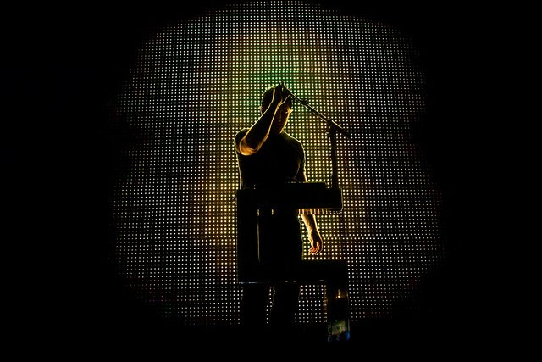
CC BY-NC
https://wiki.creativecommons.org/NonCommercial_interpretation
Notes:
This license lets others remix, tweak, and build upon your work non-commercially, and although their new works must also acknowledge you and be non-commercial, they don’t have to license their derivative works on the same terms.
Creative Commons NC licenses expressly define NonCommercial as “not primarily intended for or directed towards commercial advantage or monetary compensation.” ^{[2]} The inclusion of “primarily” in the definition recognizes that no activity is completely disconnected from commercial activity; it is only the primary purpose of the reuse that needs to be considered.
The definition of NonCommercial is intentionally flexible; the definition is specific enough to make its intended operation and reach clear, but versatile enough to cover a wide variety of use cases. The definition sets out a principle for determining what uses do and do not qualify, but generally does not list specific use cases. *
CC cannot advise you on what is and is not commercial use. If you are unsure, you should either contact the rights holder for clarification, or search for works that permit commercial uses.
Use examples-
Brooklyn Museum- The Brooklyn Museum is a major contributor to the commons on Flickr and licenses its online image collection under a CC Attribution-NonCommerical license license. According to chief of technology Shelley Bernstein, “We had started with [the] CC-BY-NC-ND [license] back in 2004 and having had a good experience, wanted to open it up a bit more. CC allows us to change as we grow and that’s very valuable — it means we can take small steps toward larger goals and do so as the institution feels comfortable.”
Wired.com photography- Wired.com staff-produced photos are released under a CC BY-NC license. Says Wired.com’s former Editor in Chief Evan Hansen, “At Wired.com, we’ve benefited from CC-licensed photos for years — thank you sharers! Now we’re going to start sharing ourselves.”
………………………………………………………………………………………………………………………………….
(aside from peer-to-peer file sharing)- the exchange of an NC-licensed work for another copyrighted work via peer-to-peer file sharing networks or otherwise is not a violation of the NC term provided no compensation changes hands

Slide 14
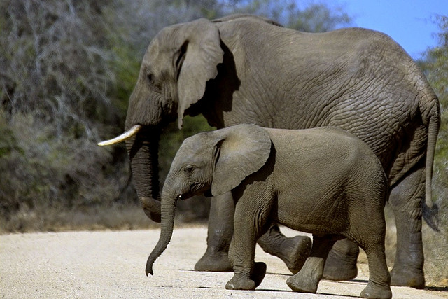
CC BY-NC-SA
Notes:
This license lets others remix, tweak, and build upon your work non-commercially, as long as they credit you and license their new creations under the identical terms.
Use examples-
MIT Open CourseWare
MIT OpenCourseWare has been releasing its materials — web versions of virtually all MIT course content — under a CC BY-NC-SA license since 2004. Today, MIT OCW has over 2000 courses available freely and openly online for anyone, anywhere to adapt, translate, and redistribute. MIT OCW have been translated into at least 10 languages, including Spanish, Portuguese, Chinese, French, German, Vietnamese, and Ukrainian. In 2011, MIT OCW celebrated its 10th anniversary, having reached 100 million individuals, and announced MITx, an initiative to provide certification for completion of its courses. The OpenCourseWare concept has now spread to hundreds of universities worldwide.
Cory Doctorow- Boing Boing editor Cory Doctorow is a writer, blogger, and science fiction author with a vast amount of work under his name. As an early adopter of Creative Commons, Cory has produced many publications under CC licenses since 2003, including Little Brother under CC BY-NC-SA which spent 4 weeks on the NYTimes bestseller list. “I use CC for my speeches, for my articles and op-eds, and for articles and stories that I write for ‘straight’ magazines from Forbes to Radar. My co-editors and I use CC licenses for our popular blog, Boing Boing, one of the most widely read blogs in the world. These licenses have allowed my work to spread far and wide, into corners of the world I never could have reached.”

Slide 15
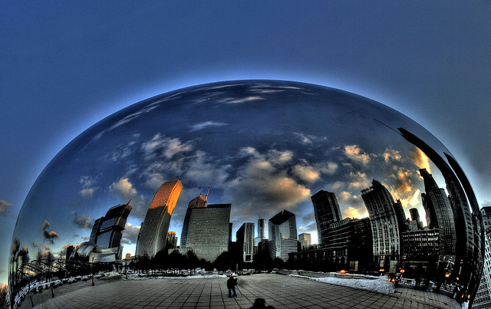
CC BY-ND
http://mollykleinman.com/2008/10/20/cc-howto-no-derivatives/
Notes:
This license allows for redistribution, commercial and non-commercial, as long as it is passed along unchanged and in whole, with credit to you.
Adaptations of NoDerivatives material permitted when not shared
In Version 4.0, licensees are granted permission to create adaptations of material licensed under one of the NoDerivatives licenses, but not permission to share the adaptations publicly. In general, private personal use does not require the permission of the licensor and, therefore, does not require that the conditions of the CC license be followed.
No Derivatives licenses do not prevent people from making fair uses of the work, which may include copying excerpts, creating parodies, and other activities that involve using the work without making an exact reproduction.
Use example- GNU and FSF
The Free Software Foundation (FSF) is dedicated to promoting computer users’ right to use, study, copy, modify, and redistribute computer programs. The FSF promotes the development and use of free software, in particular the GNU operating system and its GNU/Linux variants, and free documentation for free software. The FSF also helps to spread awareness of the ethical and political issues of freedom in the use of software, and its websites (fsf.org and gnu.org) are an important source of information about GNU/Linux. The FSF licenses both websites under the CC BY-ND license, particularly recommending this license for its works of opinion.

Slide 16
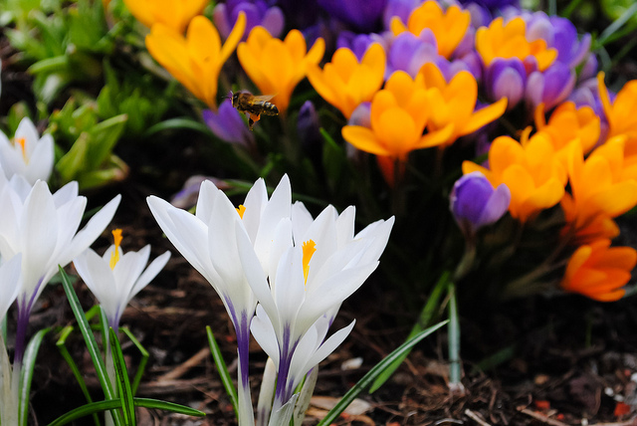
CC BY-NC-ND
Notes:
CC BY NC ND This license is the most restrictive of our six main licenses, only allowing others to download your works and share them with others as long as they credit you, but they can’t change them in any way or use them commercially.
Use examples-
TED Talks videos- The popular TED Talks are licensed under the CC BY-NC-ND license, which allows them to be redistributed unmodified for noncommercial purposes. Says TED Media’s Executive Producer June Cohen, “Creative Commons was the most efficient way to empower the growth of our product and free us from conversations about what could or couldn’t be done with our videos.” Though TED doesn’t allow remixes of its videos without its consent and the consent of the speaker, TED does encourage translations through its Open Translation Project. Since releasing videos under CC, TED Talks have been viewed over 200 million times.

Slide 17
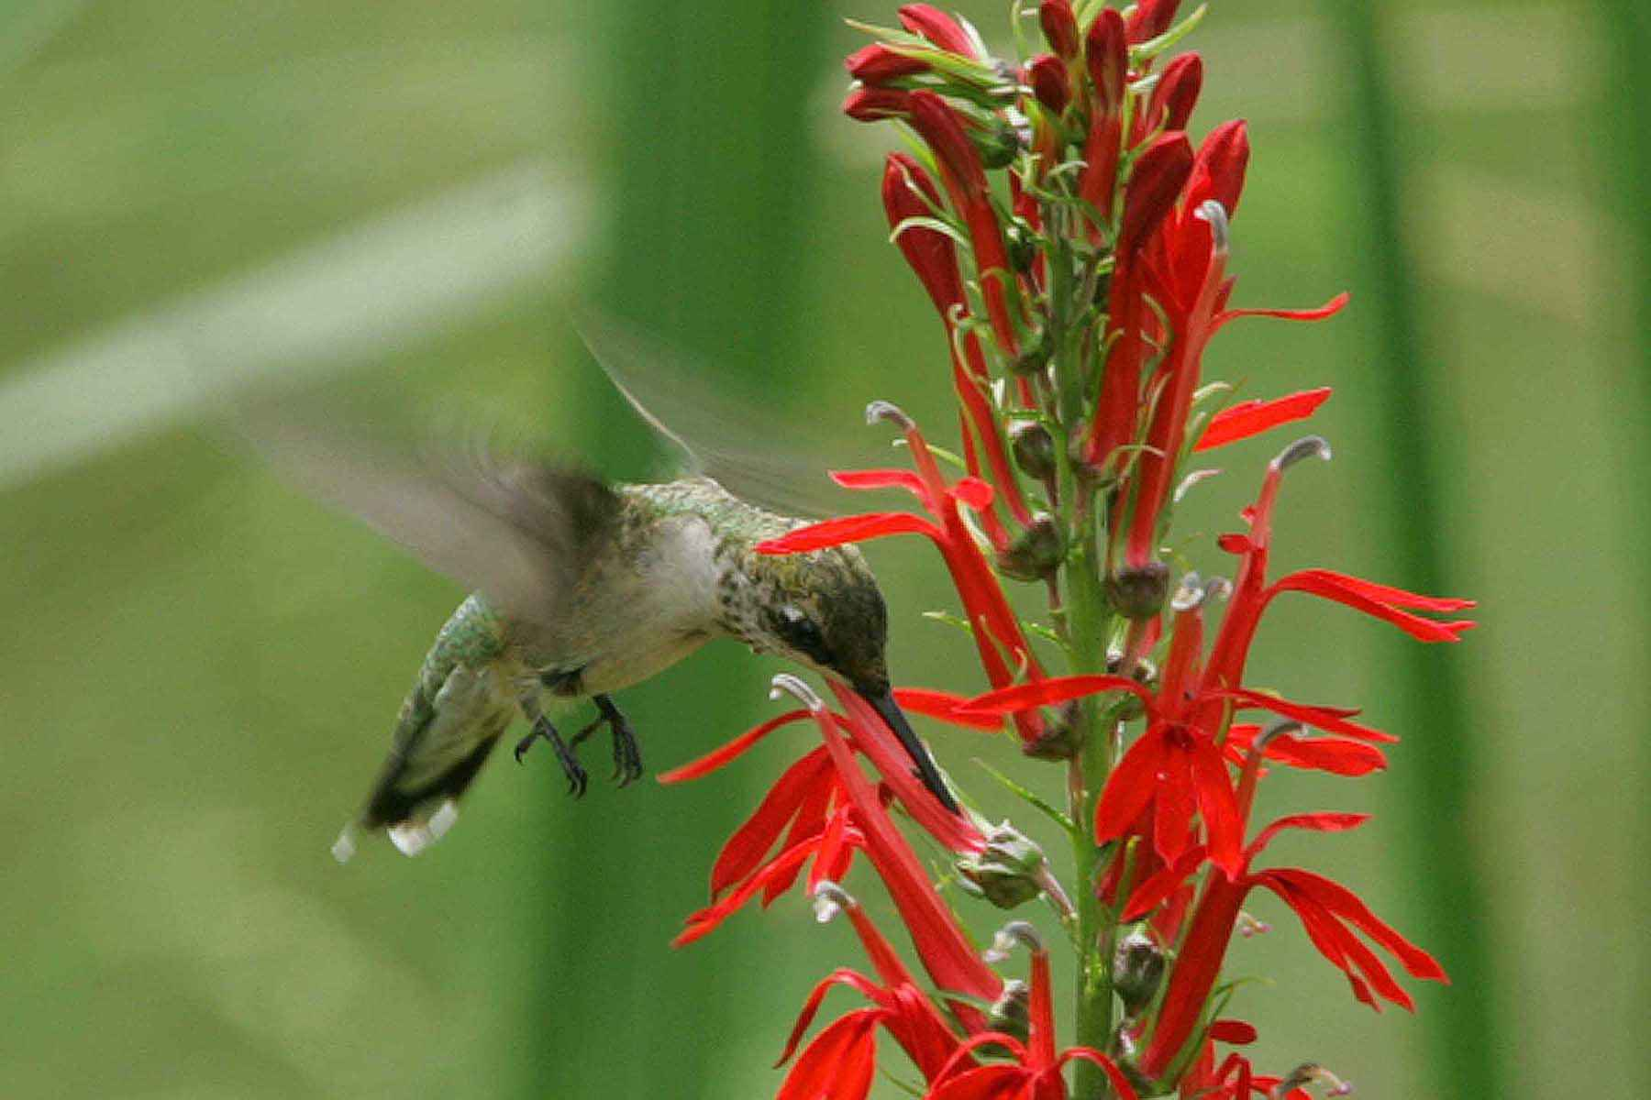

Public Domain
Notes:
CC zero is a tool for your to waive all of your copyrights in a work, effectively dedicating it to the public domain. In this sense, CC0 is often called the public domain dedication tool. CC ZERO = you waiving all of YOUR rights so that you have zero rights left in a work.
Examples of Creative Commons License Use
Europeana — Europe’s digital library — releases its metadata into the public domain using CC0.
Figshare- figshare allows researchers to publish all of their research outputs in an easily citable, searchable, shareable manner. Figshare has adopted CC0 as the default tool for researchers to share their datasets.
A work is in the public domain when it is free of copyright by virtue of
No copyright
copyright has expired
Creator has
Most films and photographs before 1955; other materials if author died before 1955.
Can do anything you want without asking extra permission (even if a donor doesn’t like it)
Can be re-used from archive websites without the archive’s permission (even if archivedoesn’t like it)
Watch out for . . . underlying works that are still in copyright (eg script);
Bad practice to claim copyright in PD works (even high quality) - Bridgeman v Corel Don't use terms of use to try to restrict – probably not effective and bad practice Ownership of object =/ right to prevent copying
Users not subject to donor agreements
Do mark works as PD - use CC's PD Mark (it has metadata)
Use CC0 to make things PD if you have the rights
If cautious use custom statement - eg “no known rights”
Examples of Creative Commons License Use
Europeana — Europe’s digital library — releases its metadata into the public domain using CC0.
Figshare- figshare allows researchers to publish all of their research outputs in an easily citable, searchable, shareable manner. Figshare has adopted CC0 as the default tool for researchers to share their datasets.
Open Goldberg Variations- before OGV- public domain recordings of Bach’s Goldberg Variations were hard to find, even though the scores themselves were in the public domain.
Make it work for you – Eg Rijkstudio – 150,000 PD works, high res, commercial use; massive publicity (competition), community, sales (see also Powerhouse, Pratham Books)

Slide 18
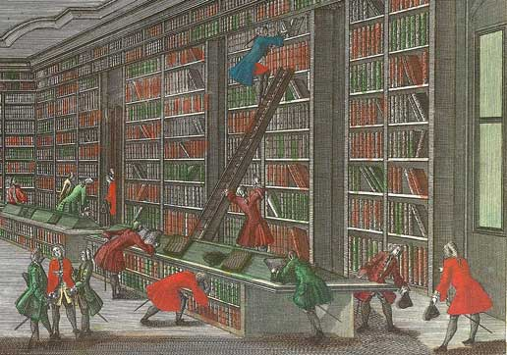

Public Domain
Notes:
The Public Domain Mark is for marking works that are already in the public domain.
Developed with reference to “no known copyright” statements adopted by many leading cultural heritage institutions, including contributors to Flickr Commons, the PDM is the only mark of its kind, and the only widely-adopted and globally accepted mark that communicates a work’s public domain status worldwide.
“This work has been identified as being free of known restrictions under copyright law, including all related and neighboring rights”
Users not subject to donor agreements
Do mark works as PD - use CC's PD Mark (it has metadata)
Use CC0 to make things PD if you have the rights
If cautious use custom statement - eg “no known rights”
Examples of Creative Commons License Use
Europeana—Europe’s digital library, museum and archive—is the first major adopter of the Public Domain Mark. Europeana estimates that by mid-2011, the Public Domain Mark will be used in connection with millions of out-of-copyright works made available through its portal.
“An important part of our mandate is to ensure that digitized works made available through Europeana are properly labeled with rights information, including when a work is free of known copyright restrictions so that teachers, students and others can freely use it in their work, changing it and remixing it as they wish,” noted Jill Cousins, Executive Director of Europeana.
Flickr- supports both the CC0 & the Public Domain Mark

Slide 19
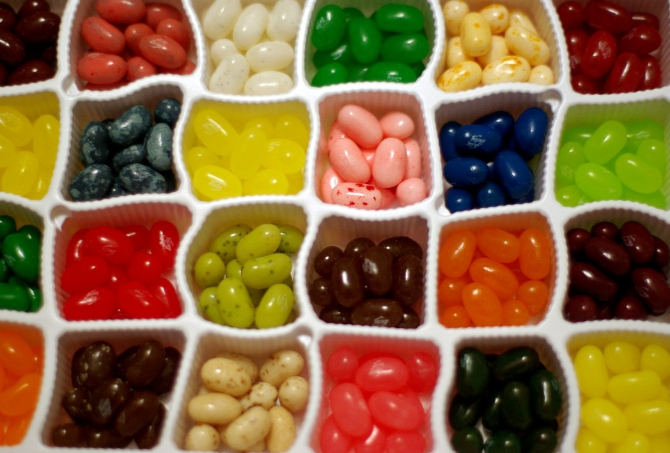
Combining differently licensed materials
Notes:
Including a CC-licensed work in a collection (a work comprised of separate and independent works) is permitted by all CC licenses. However the collective work as a whole is licensed, the license on the collection does not affect the CC license applied to the work.
If the combination does not create an adaptation, then you may combine any CC-licensed content so long as you provide attribution and comply with the NonCommercial restriction if it applies.
If you want to combine material in a way that results in the creation of an adaptation (i.e. a “remix”), then you must pay attention to the particular license that applies to the content you want to combine.
The NoDerivatives licenses do not permit remixing except for private use. All the other CC licenses allow remixes, but may impose limitations or conditions on how the remix may be used.
For example, if you create a remix with material licensed under a ShareAlike license, you need to make sure that all of the material contributed to the remix is licensed under the same license
Similarly, if you want to use a remix for commercial purposes, you cannot incorporate material released under one of the NonCommercial licenses.

Slide 20

CC & software
https://wiki.creativecommons.org/Frequently_Asked_Questions#Can_I_apply_a_Creative_Commons_license_to_software.3F
Notes:
Not recommended for software. CC recommends Free Software Foundation or Open Source Initiative.
Unlike software-specific licenses, CC licenses do not contain specific terms about the distribution of source code, which is often important to ensuring the free reuse and modifiability of software.
Many software licenses also address patent rights, which are important to software but may not be applicable to other copyrightable works.
Additionally, our licenses are currently not compatible with the major software licenses, so it would be difficult to integrate CC-licensed work with other free software. Existing software licenses were designed specifically for use with software and offer a similar set of rights to the Creative Commons licenses.
Our licenses are currently not compatible with the GPL, though the CC0 Public Domain Dedication is GPL-compatible and acceptable for software. For details, see the relevant CC0 FAQ entry. We are looking into compatibility of BY-SA with GPL in the future; see the license compatibility page for more information.)
While we recommend against using a CC license on software itself, CC licenses may be used for software documentation, as well as for separate artistic elements such as game art or music.

Slide 21
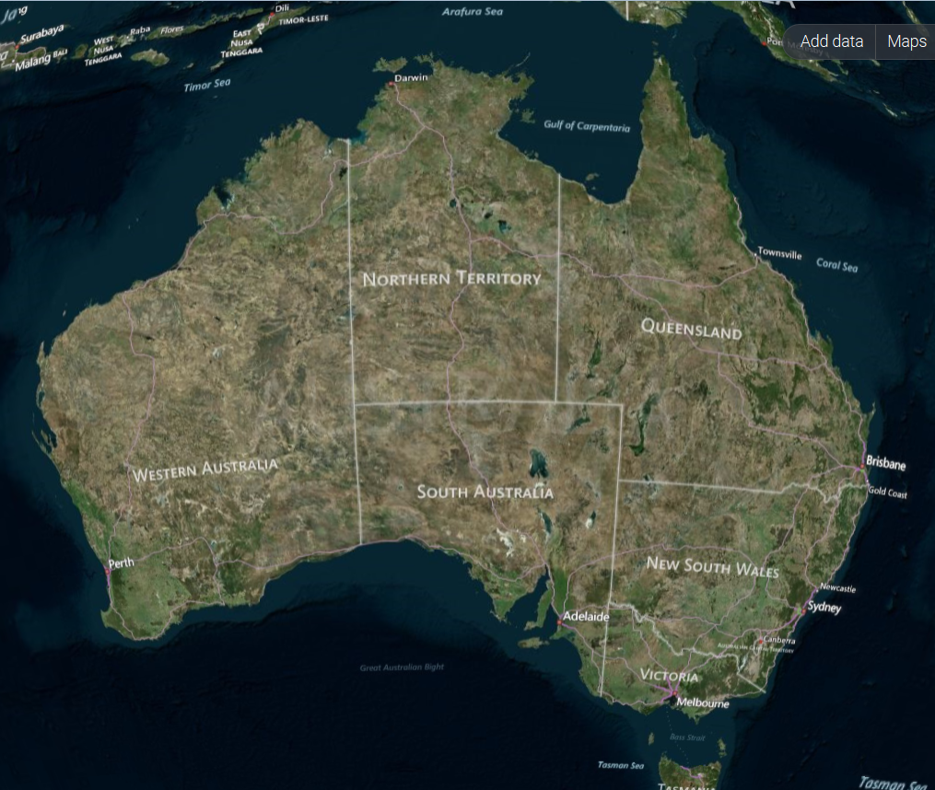
CC & data
http://www.ausgoal.gov.au/research-data-faqs
Notes:
CC licences can be applied to data.
There a huge benefits to open data societally. Making research data open is a big topic.
All levels of Aus Government committed to open data and supporting the open data movement- Open Data Initiatives…
Govt geo-spatial data sets- national map
Qld Govt Open Data Portal…
ODI Q- open data institute Qld-
Govhack.org- civic hackers- encouraging creative re-use of govt data-
One of the outcomes is driving traffic on to govt websites
I’ll refer you to the Ccau affiliate AusGOAL website for information

Slide 22
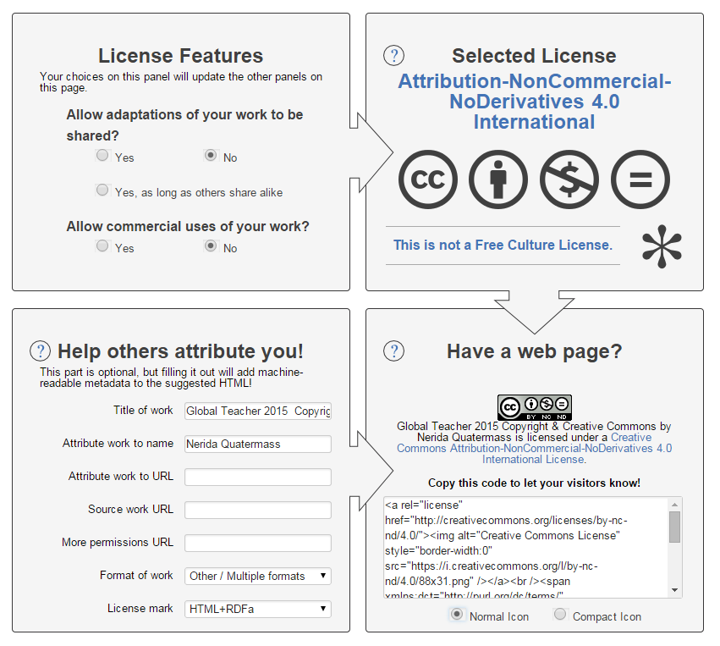
Applying a Licence to your Work
http://creativecommons.org/choose/
Notes:
When you choose a licence using the Creative Commons licence chooser, you are provided with metadata in the form of HTML code for that licence.
By copying and pasting it into your website you can display the notice anywhere you choose on a page.
When someone clicks on the icon or the licence name in the notice, they are taken to the Commons Deed for that licence.
Under the standard questions on the licence chooser, you can also include descriptive metadata such as who created it, the name of the work and where it is hosted. This is useful for helping potential licensees identify the original work and attribute it.
You can of course also add your own notice information into the metadata.
Answer the questions
Describe the work
Select normal or compact icon
Copy/paste- embed the button and notice onto the work

Slide 23
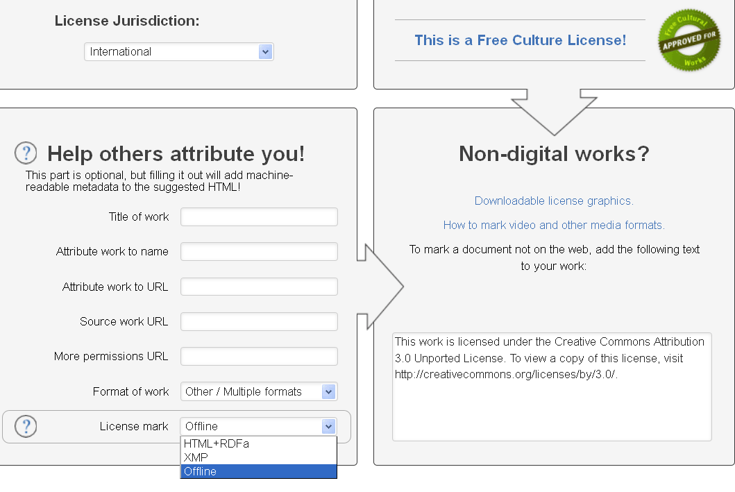
Notes:
Guidance on marking your content in different mediums

Slide 24
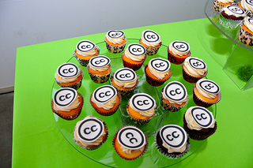
Attribution
https://wiki.creativecommons.org/Best_practices_for_attribution
Notes:
Title
Author
Source
License
Requirements have changed with versioning, but generally and currently-
attribution is explicitly allowed to be reasonable to the means, medium, and context of how one shares a work
In V 4 licensees are required to indicate if they made modifications to the licensed material. E.g. "This section is an excerpt of the original." cropped a photo
The title is not required for proper attribution in the 4.0 licenses. It is required in all earlier versions.
a URI is required for proper attribution, if it is reasonably practicable to include

Slide 25

Marking content
https://wiki.creativecommons.org/images/6/61/Creativecommons-licensing-and-marking-your-content_eng.pdf

Slide 26
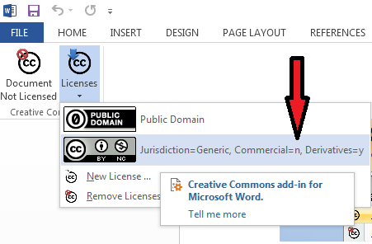
Marking content- CC Add-in for MS Office
https://www.microsoft.com/en-us/download/details.aspx?id=13303
Notes:
This add-in for Microsoft Office enables authors and editors to embed Creative Commons licenses directly into Microsoft Word, PowerPoint, and Excel documents. With a Creative Commons license, authors can express their intentions regarding how their works may be used by others. The add-in allows the selection of a license, downloads it from the Creative Commons website, and inserts it directly into the working document.e embedded in Microsoft Word, Excel and Powerpoint documents.

Slide 27



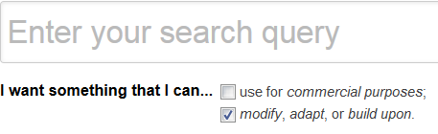
Finding CC Licensed Content
Notes:
CC Search-new search interface coming. In the meantime- useful for identifying different open media sources
Google image- locate open licenced images; and; reverse image search for licence information
Bing- filter for “License”; and, reverse image search

Slide 28
Creative Commons Resources
Web
http://creativecommons.org.au
https://creativecommons.org/examples
Wiki
https://wiki.creativecommons.org/Main_Page
Contact
Info@creativecommons.org.au

Slide 29
Credits by slide number…
4 “Three Atmospheric "Dragons": Low Pressure Areas Around the U.S.” Rob Gutro
NASA's Goddard Space Flight Center https://www.flickr.com/photos/gsfc/13545312904/in/photostream/ CC BY 2.0
11 “Yet another Eiffel tower shot” Rafael Matsunaga https://www.flickr.com/photos/rednuht/ CC BY 2.0
12 “Red Face” marco antonio torres https://www.flickr.com/photos/torres21/3733654187/ CC BY-SA
Trent Reznor / Jon Snyder/Wired.com / CC BY-NC
African Elephant by Arno Maintjes https://www.flickr.com/photos/arnolouise/705454064/ is licenced CC BY-NC-SA
Image via Creative Commons/Andrew E. Larsen (CC BY-ND 2.0)
Operation Honey Collector by Tom Heinze on Flickr is licensed CC BY-NC-ND 2.0
Ruby throated hummingbird archilochus colubris at cardinal flower royalty free stock photograph in gallery Hummingbirds is in public domain
Bibliotheca Buloviana (Ausschnitt) / Georg Daniel Heumann / Public Domain
Jelly Beans in verschiedenen Sorten http://de.wikipedia.org/wiki/Jelly_Belly#/media/File:Jelly_Belly_jelly_beans_(2),_December_2008.jpg CC BY 2.0
Source: http://www.businesskorea.co.kr/article/8611/promotion-software-industry-korean-govt-focus-qualitative-growth-software-industry
21 Source: http://nationalmap.nicta.com.au/ Image courtesy of NASA
24 "Creative Commons 10th Birthday Celebration San Francisco" by tvol is licensed under CC BY 2.0

Slide 30


This work, “Creative Commons Licences", is a derivative of Jessica Coates presentation “Creative Commons for educators http://www.slideshare.net/Jessicacoates/creative-commons-for-educators-presentation?type=powerpoint CC BY; and, Jane Park’s presentation "Creative Commons and cultural heritage" CC BY. "
Except where otherwise noted: CC BY creativecommons.org/licenses/by/4.0
Creative Commons and the double C in a circle are registered trademarks of Creative Commons in the United States and other countries. Third party marks and brands are the property of their respective holders.

